Slide 1
Introduction of Operating System

Slide 2
Operating System
“A program that acts as an intermediary between a user of a computer and computer hardware”
“Operating system controls and coordinates the use of the hardware among various applications programs for various users”
“The operating system is the one program that is running all times on the computer (usually called the Kernel), with all else being application program.

Slide 3
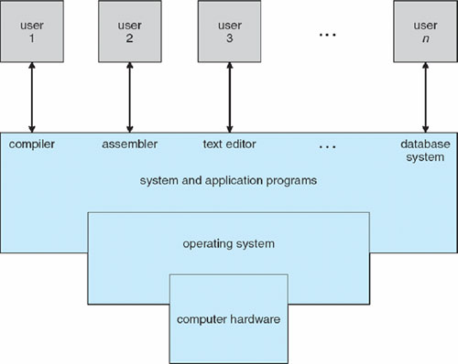
Component of Computer System

Slide 4
Operating System
Primary Goal: Convenience of use (For small PCs)
Secondary Goal: Efficient utilization of Resources i.e h/w and s/w (for large, shared and multiuser systems).

Slide 5
Bootstrapping
Booting is the process of loading operating system into main memory.
For a computer to start running, it needs to have an initial program to load and execute the boot program, which in turn loads the operating system.
The primitive loader program that can load and execute the Boot program is called Bootstrap Program.
Boot strap program is generally stored in ROM.
On- Start up, the computer automatically reads the bootstrap program.

Slide 6
Uses of Operating System
As a Government: Like a government, the OS perform no useful function for itself. It simply provides an environment within which other program can do useful work.
As a resource Manager: The OS acts a manager of the computer system resources (like software and hardware and more specifically CPU time, memory space, file storage space, I/O devices etc) and allot them to specific program and uses as necessary for their tasks.
As a Control Program: The Operating system controls the execution of user programs to prevent error and improper use of the computer. It is especially concerned with the operation and control of I/O devices

Slide 7
Simple Batch Systems ( Resident Monitor)
The emphasis was on high utilization of computers to get as much as they could from their investments.
Professional computer operators were hired which has reduced the job set up time.
Jobs with similar needs were batched together and run through the computer as group.
Automatic job sequencing was developed for automatically transferring control from one job to the next.
A small program called a resident monitor was created for this purpose. It was always resident in the memory

Slide 8
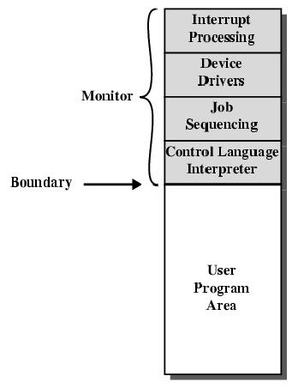
Resident Monitor
The resident monitor would automatically sequence from one program to another and from job to another.
Control card interpreter was responsible for reading and carrying out the instruction on the cards at the point of execution.
The delay between job submission and job completion is called TURNAROUND time, may result the amount of computing needed or from delays before the OS starts to process the job.

Slide 9
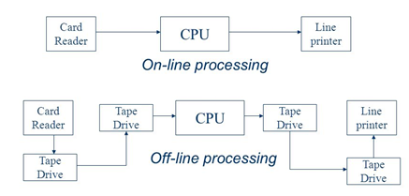
OVERLAPPED CPU and I/O
Even with automatic job sequencing, the CPU is often idle. The problem is the speed of the mechanical I/O devices which are intrinsically slower than electronic devices.

Slide 10
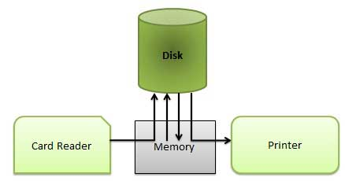
Spooling ( Simultaneous Peripheral Operation On-Line)
Random-Access Device like disk system was introduction.
Location of card images is recorded in a table kept by the operating system.
When the job is completed, the output is actually printed.
This form of processing is called Spooling.

Slide 11
Spooling ( Simultaneous Peripheral Operation On-Line)
Spooling overlaps the I/O of one job with the computation of other jobs.
Spooling has a direct beneficial effect on the performance of the system
Spooling can keep the CPU and the I/O devices working at same time at much higher rates.

Slide 12
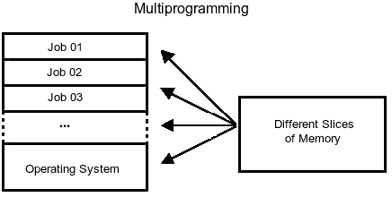
MULTIPROGRAMMED BATCH SYSTEMS
Multiprogramming increases CPU utilization by organizing jobs so that the CPU always has something to execute.
The OS picks and begins to execute one of the jobs in the memory.
The OS switches to and executes another jobs, when one job needs to wait for some I/O operation.
As long as there is always some jobs to execute, the CPU utilization increases.

Slide 13
MULTIPROGRAMMED BATCH SYSTEMS
If several jobs are ready to be brought into memory This decision is job scheduling. [ Long Term Scheduler]
In addition if several jobs are ready to run at the same time, the system must choose among them. This decision is CPU Scheduling. [ Short Term Scheduler]

Slide 14
Time sharing systems
In Batch system user cannot interact with the jobs when it is executing, the user must set up the control cards to handle all possible outcomes.
A long turnaround time inhibits experimentation with a program.
Time sharing (Multitasking) is a logical extension of multiprogramming. Multiprogramming jobs are executed by the CPU Switching between them, but the switched occurs so frequently that the users may interact with each program while it is running.

Slide 15
Time sharing systems Cont……
A time shared system uses CPU scheduling and multiprogramming to provide each user with a small portion of a time shared computer.
Each user has at least one separate program in memory. A program that is loaded into memory and is executing is commonly referred to as a process.
It allows many users to share the computer simultaneously.
To ensure orderly execution, the system must provide mechanism for jobs synchronization and communication and must ensure that jobs do not get stuck in an deadlock forever waiting for each other.

Slide 16
Parallel Systems
Having more than one processor in close communication sharing the computer bus, the clock and sometimes memory and peripheral devices. These systems are referred as tightly coupled systems.
One Advantage is increased throughput.
Save money compared to multiple single systems because of sharing of peripheral, cabinets and power supply.
Increase reliability and provide “graceful degradation” (ability to continue providing services proportional to the level of non-failed hardware).
System designed for graceful degradation is called “Fail-Soft”.

Slide 17
Parallel System Cont….
“Tandem System” uses both Hardware and Software duplication to ensure continued operation despite faults. The system consists of two identical processors, each with its own local memory and connected by a bus.
One processor is called Primary and other is called Backup or Secondary processor.
Two copies are kept of each process; One for primary and other for Secondary.
If Failure is detected, the backup copy is activated and is restarted from the most recent checkpoint.

Slide 18
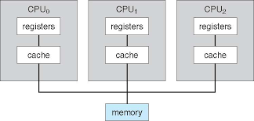
Type of Parallel System
1. Symmetric Multiprocessing :
Each processor runs an identical copy of the OS and copies communicate with one another as needed.
Each processor performs all tasks within OS.
All Processor are Peer and no Master Slave relationship exists.
In Symmetric Multiprocessing treats all processors as equals and no I/O can be processed on any CPU.

Slide 19
Type of Parallel System
1. Asymmetric Multiprocessing :
Each processor is assigned a specific task.
A master processor controls the system. The other processors look to the master for instructions or predefined task. Thus, this defines master-slave relationship.
Master Processor schedules and allocates the work to the slave processor.
Each processor has its own address space.

Slide 20
Distributed System
Distribute computation among several processors.
The processor does not share memory or a clock. Instead each processor has its own local memory
The Processor communicates with one another through various communications line such as high speed buses and telephone lines.
These systems are usually referred as Loosely Coupled Systems.
The processors may vary in size and functionality. These processors are referred as sites, nodes and computers.
Advantages :
        Resources Sharing:
        Computational Speed-up
        Reliability
        Communication

Slide 21
Real Time System
It is used when there are rigid time requirement on the operation of a processor or the flow of data and the thus is often used as a control device in a dedicated application.
They tend to have very specific tasks. They have no user interface.
Sensors bring data to the computer.
The computer must analyze the data and possibly adjust controls to modify the sensor input.
These systems are embedded system where the tasks are already integrated in circuits which executed without an OS.

